Slide 1
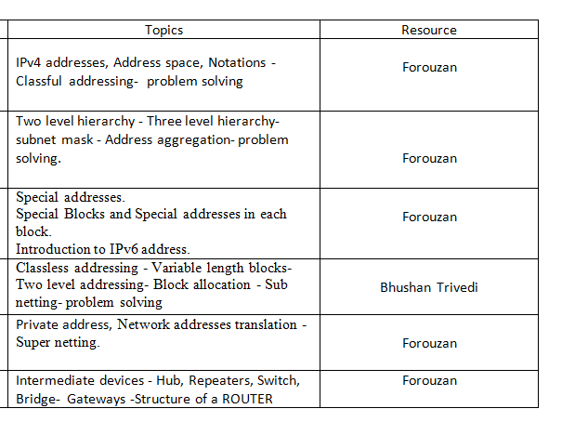
Unit 2

Slide 2
IPv4 addresses, Address space, Notations -Classful addressing- problem solving

Slide 3
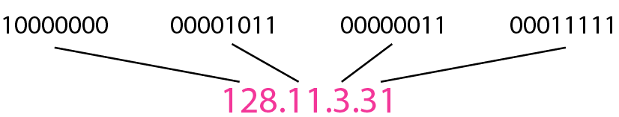
IPv4 Address ,address space
The IPv4 addresses are unique and universal.
An IPv4 address is 32 bits long.
The address space of IPv4 is 2³² (4,294,967,296)
Notation.
Binary notation
Dotted-decimal notation

Slide 4
IPv4
32 bits long
An IPv4 address is a 32-bit address that uniquely and universally defines the connection of a device (for example, a computer or a router) to the Internet.
Unique and Universal.
Two devices on the Internet can never have the same address at the same time
Addressing system must be accepted by any host that wants to be connected to the Internet.

Slide 5
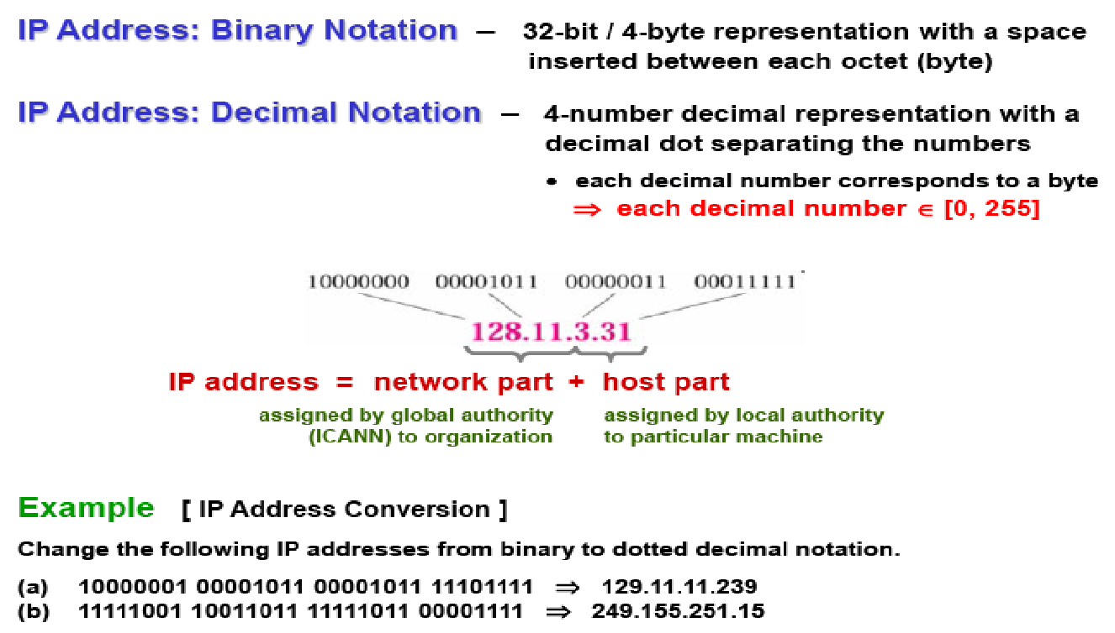
IPV4 NOTATIONS

Slide 6
An easier way to remember IP addresses is by assigning to them a name.
(e.g., www.google.com), which is resolver through the Domain Name System (DNS).
Strictly speaking, an IP address identifies an interface that is capable of sending and receiving IP datagrams.
One system can have multiple such interfaces.
Usually, hosts have only one interface (thus, one IP address), whereas routers have many interfaces (thus, many IP addresses).

Slide 7
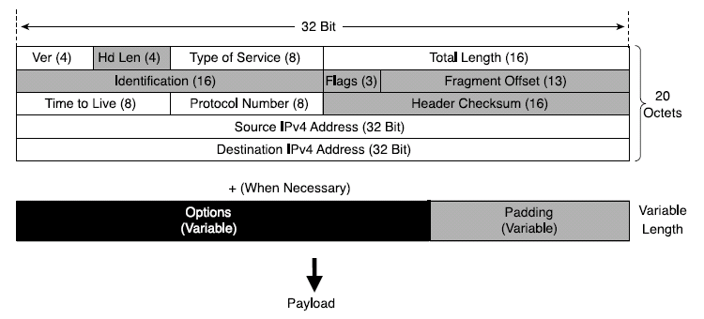
IPv4 Header Structure
basic IPv4 header contains 12 fields.
each field of the IPv4 header has a specific use.
Shaded field are removed in IPv6.
Notes:
Version (4 bits)--Represents the version of the IP protocol. In this case, the field is set to 4.
Header Length (4 bits)--The length in octets of the packet header.
Type of Service (ToS) (8 bits)--This field carries information that enables routers to classify and forward packet in a differentiated manner. It is an important service identifier used in implementing quality of service (QoS).
Total Length (16 bits)The length in octets of the entire packet, header plus payload. With 16 bits available in this field, the maximum length of an IPv4 packet is 65,535 octets.
Identification (16 bits), Flags (3 bits), Fragment Offset (13 bits)--These three fields enable IPv4 networks to support packet fragmentation to negotiate forwarding over links supporting various maximum transmission units (MTUs). Fragmentation is done as needed by the routers along the path of the packet.
Time To Live (8 bits)--It is important to protect a network's resources from packets that loop due to routing problems. This field is used to count down the number of routers that switched the packet. The packet is discarded when the value of this field is 0.
Protocol Number (8 bits)--The Protocol Number lists the upper- layer protocol (TCP, UDP, ICMP, and so on) that is present in the packet payload. The numbers that represent these protocols are assigned by IANA (http://www.iana.org/assignments/protocol- numbers).
Header Checksum (16 bits)--The integrity of the packet header is verified by comparing the computed checksum with the value listed in this field.
Source IPv4 Address (32 bits)--The IPv4 address of the node that sourced the packet.
Destination IPv4 Address (32 bits)--The IPv4 address of the packet destination node.
Options (variable length)--This field is meant as a placeholder for the information relevant to proper handling of the data carried by the packet, information that is not represented in the other fields of the header. Because of this field, the IPv4 header has a variable length, justifying the need for the Header Length field.
Padding (variable length)--Is used to align the variable-length Options field to the 32-bit boundary.

Slide 8
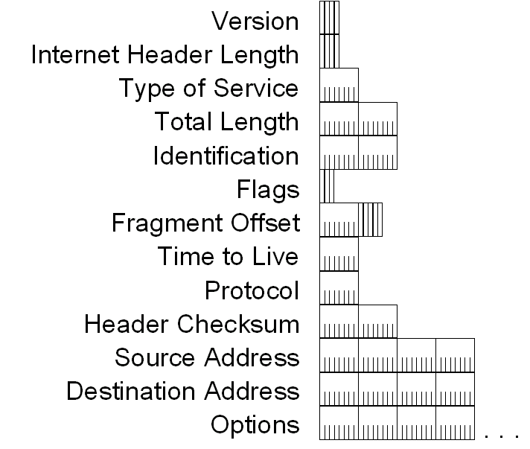
IPv4 Header - Review

Slide 9
IPv4 Header - Review
Version (4 bits)
Indicates the version of IP and is set to 4.
Internet Header Length (4 bits)
Indicates the number of 4-byte blocks in the IPv4 header.
Because an IPv4 header is a minimum of 20 bytes in size, the smallest value of the Internet Header Length (IHL) field is 5.
Type of Service (4 bits)
Indicates the desired service expected by this packet for delivery through routers across the IPv4 internetwork.

Slide 10
IPv4 Header - Review
Total Length (16 bits)
Indicates the total length of the IPv4 packet (IPv4 header + IPv4 payload) and does not include link layer framing.
Identification (16 bits)
Identifies this specific IPv4 packet.
The Identification field is selected by the originating source of the IPv4 packet. If the IPv4 packet is fragmented, all of the fragments retain the Identification field value so that the destination node can group the fragments for reassembly.
Flags (3 bits)
Identifies flags for the fragmentation process.
There are two flags—one to indicate whether the IPv4 packet might be fragmented and another to indicate whether more fragments follow the current fragment.
Fragment Offset (13 bits)
Indicates the position of the fragment relative to the original IPv4 payload.

Slide 11
IPv4 Header - Review
Time to Live ( 8 bits)
Indicate the maximum number of links on which an IPv4 packet can travel before being discarded.
Originally used as a time count with which an IPv4 router determined the length of time required (in seconds) to forward the IPv4 packet, decrementing the TTL accordingly. When the TTL equals 0,an ICMP Time Expired-TTL Expired in Transit message is sent to the source IPv4 address and the packet is discarded.
Protocol (8 bits)
Identifies the upper layer protocol.
For example, TCP uses a Protocol of 6, UDP uses a Protocol of 17, and ICMP uses a Protocol of 1.
The Protocol field is used to demultiplex an IPv4 packet to the upper layer protocol.

Slide 12
IPv4 Header - Review
Header Checksum (16 Bits)
Provides a checksum on the IPv4 header only.
The IPv4 payload is not included in the checksum calculation as the IPv4 payload and usually contains its own checksum..
Source Address ( 32 bits)
Stores the IPv4 address of the originating host.
Destination Address (32 bits)
Stores the IPv4 address of the destination host.
Options (multiple of 32 bits)
Stores one or more IPv4 options.

Slide 13
Types of addressing
Classful Addressing
Classless Addressing

Slide 14
Classful Addressing and Problem solving

Slide 15
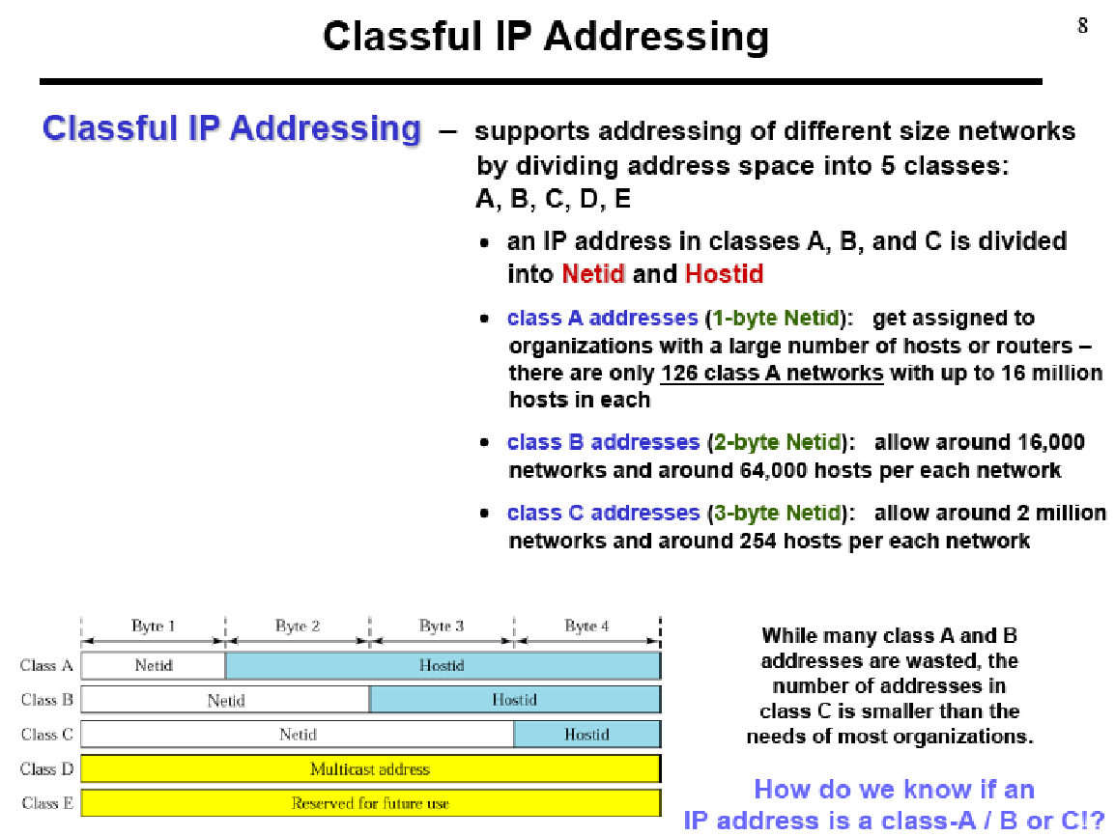

Slide 16
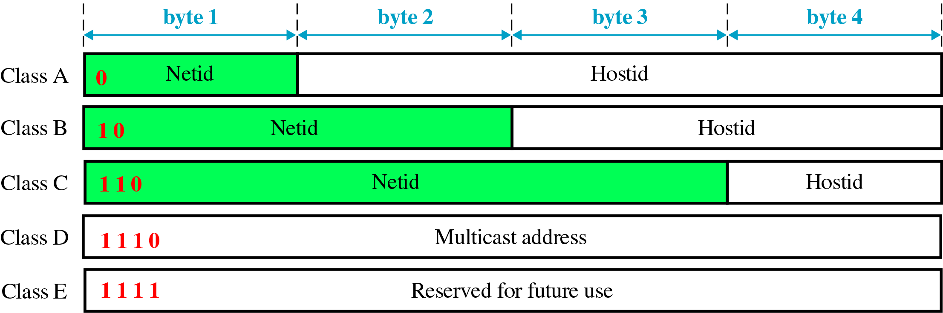
Classful Addressing
In classful addressing, the address space is divided into five classes: A, B, C, D, and E.

Slide 17
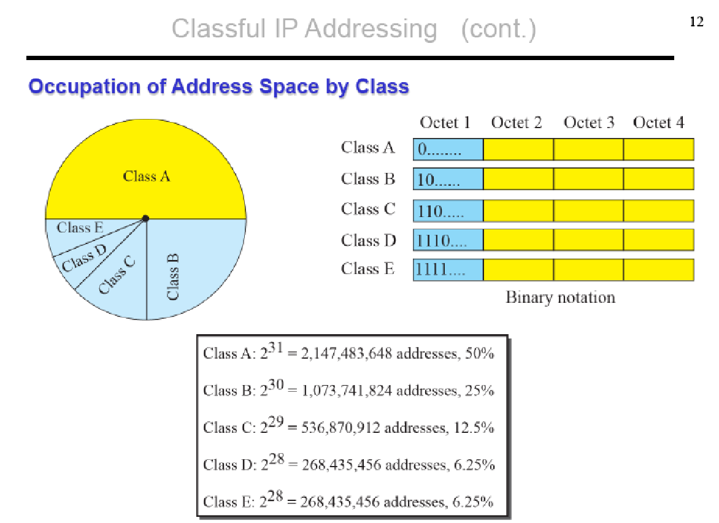

Slide 18
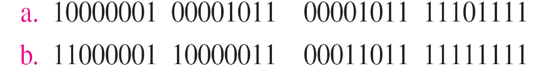
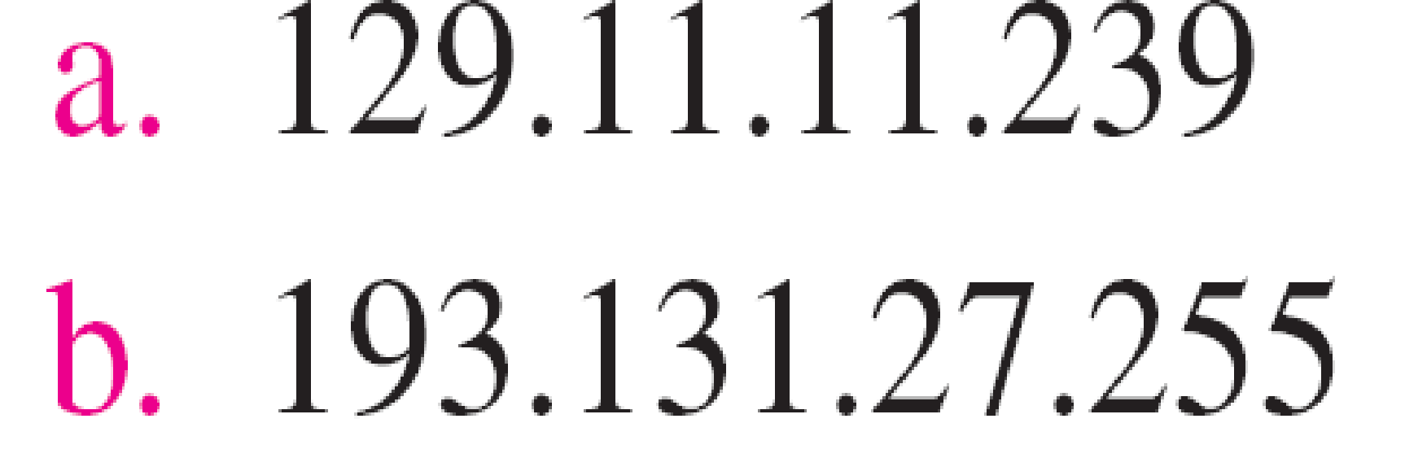
Example 19.1
Change the following IPv4 addresses from binary notation to dotted-decimal notation.
Change the following IPv4 addresses from binary notation to dotted-decimal notation.
Solution
We replace each group of 8 bits with its equivalent decimal number (see Appendix B) and add dots for separation.
Solution
We replace each group of 8 bits with its equivalent decimal number (see Appendix B) and add dots for separation.

Slide 19
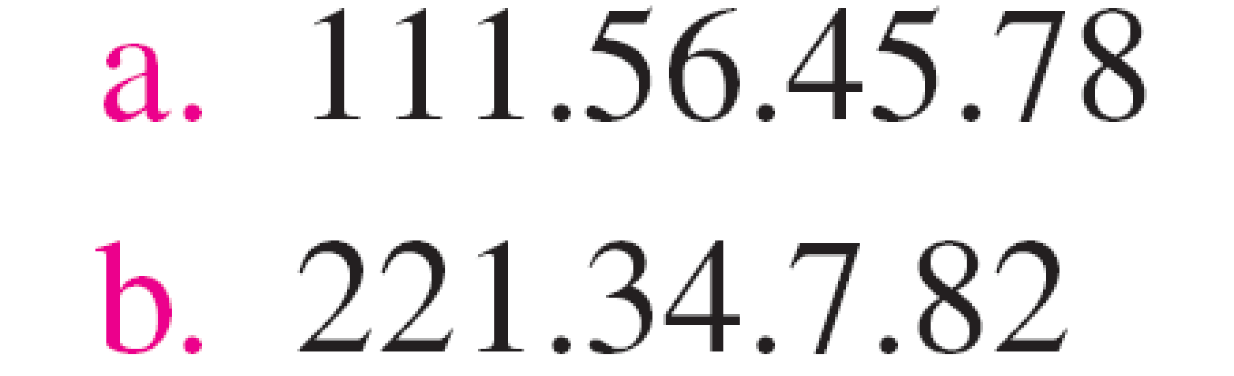
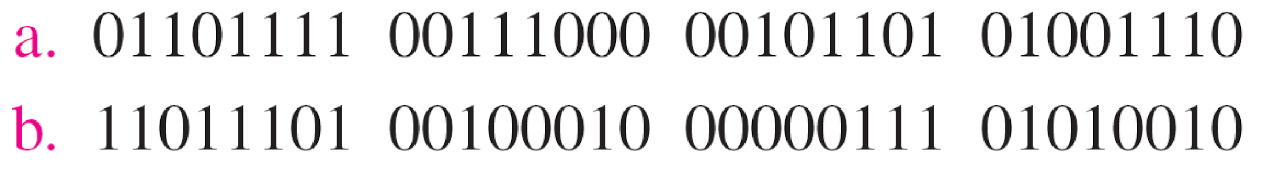
Example 19.2
Change the following IPv4 addresses from dotted-decimal notation to binary notation.
Solution
We replace each decimal number with its binary equivalent

Slide 20
Example 19.4
Find the class of each address.
a. 00000001 00001011 00001011 11101111
b. 11000001 10000011 00011011 11111111
c. 14.23.120.8
d. 252.5.15.111
Solution
a. The first bit is 0. This is a class A address.
b. The first 2 bits are 1; the third bit is 0. This is a class C address.
c. The first byte is 14; the class is A.
d. The first byte is 252; the class is E.

Slide 21
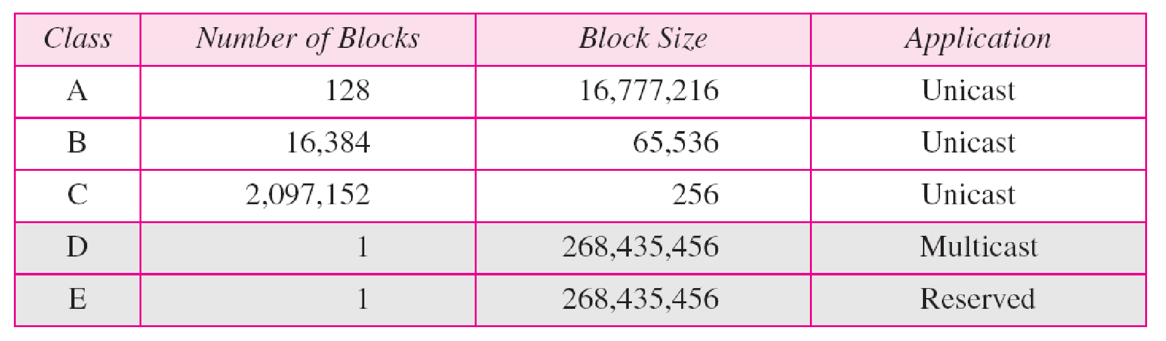
Table 19.1 Number of blocks and block size in classful IPv4 addressing

Slide 22

Note
In classful addressing, a large part of the available addresses were wasted.

Slide 23
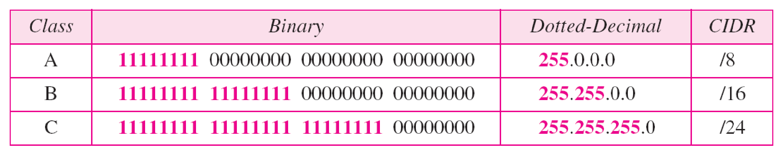
Table 19.2 Default masks for classful addressing

Slide 24
Note
Classful addressing, which is almost obsolete, is replaced with classless addressing.

Slide 25
Note
In IPv4 addressing, a block of addresses can be defined as
x.y.z.t /n
in which x.y.z.t defines one of the addresses and the /n defines the mask.

Slide 26
Note
The first address in the block can be found by setting the rightmost 32 − n bits to 0s.

Slide 27
Example 19.6
A block of addresses is granted to a small organization. We know that one of the addresses is 205.16.37.39/28. What is the first address in the block?
Solution
The binary representation of the given address is
11001101 00010000 00100101 00100111
If we set 32−28 rightmost bits to 0, we get
11001101 00010000 00100101 0010000
or 205.16.37.32.
This is actually the block shown in Figure 19.3.

Slide 28
Note
The last address in the block can be found by setting the rightmost 32 − n bits to 1s.

Slide 29
Example 19.7
Find the last address for the block in Example 19.6.
Solution
The binary representation of the given address is
11001101 00010000 00100101 00100111
If we set 32 − 28 rightmost bits to 1, we get
11001101 00010000 00100101 00101111
or
205.16.37.47
This is actually the block shown in Figure 19.3.

Slide 30
Note
The number of addresses in the block can be found by using the formula 2^{32−n}.

Slide 31
Example 19.8
Find the number of addresses in Example 19.6.
Solution
The value of n is 28, which means that number of addresses is 2 ³²⁻²⁸ or 16.

Slide 32
Example 19.9
Another way to find the first address, the last address, and the number of addresses is to represent the mask as a 32-bit binary (or 8-digit hexadecimal) number. This is particularly useful when we are writing a program to find these pieces of information. In Example 19.5 the /28 can be represented as
11111111 11111111 11111111 11110000
(twenty-eight 1s and four 0s).
Find
a. The first address
b. The last address
c. The number of addresses.

Slide 33
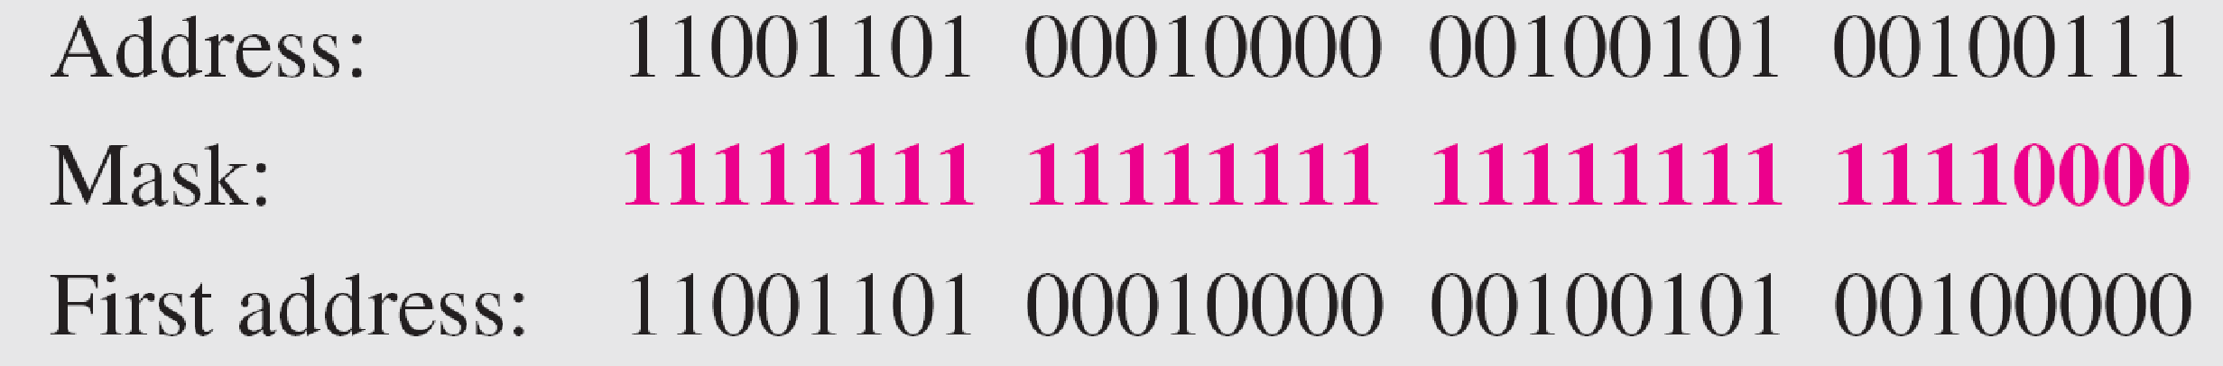
Example 19.9 (continued)
Solution
a. The first address can be found by ANDing the given addresses with the mask. ANDing here is done bit by bit. The result of ANDing 2 bits is 1 if both bits are 1s; the result is 0 otherwise.

Slide 34
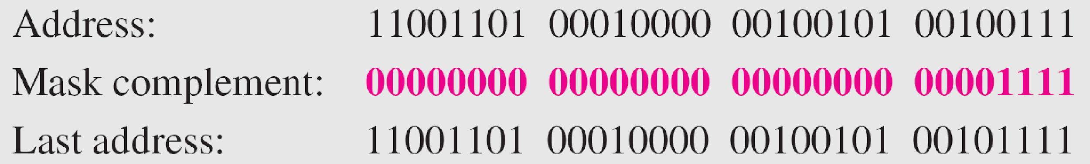
Example 19.9 (continued)
b. The last address can be found by ORing the given addresses with the complement of the mask. ORing here is done bit by bit. The result of ORing 2 bits is 0 if both bits are 0s; the result is 1 otherwise. The complement of a number is found by changing each 1 to 0 and each 0 to 1.

Slide 35
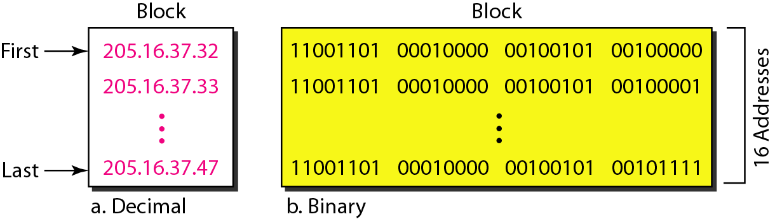
Figure 19.4 A network configuration for the block 205.16.37.32/28

Slide 36
Note
The first address in a block is normally not assigned to any device; it is used as the network address that represents the organization to the rest of the world.

Slide 37
Two level hierarchy - Three level hierarchy- subnet mask - Address aggregation- problem solving.

Slide 38
Hierarchy of IPv4 Addressing
Each address in the block can be considered as a two-level hierarchical structure: the leftmost n bits (prefix) define the network; the rightmost 32 − n bits define the host.
Why Hierarchy?

Slide 39
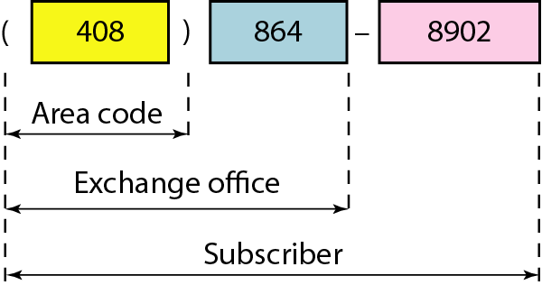
Figure 19.5 Two levels of hierarchy in an IPv4 address

Slide 40
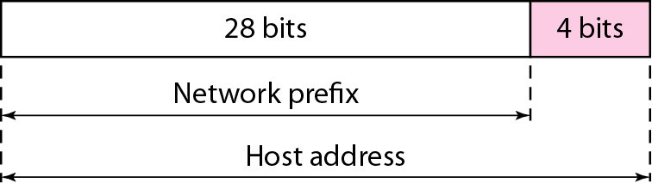
Two Level of Hierarchy

Slide 41
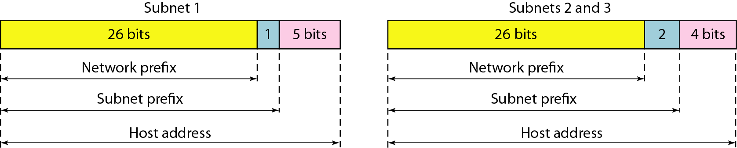
Three Level of Hierarchy

Slide 42
Address Aggregation
IP Address Aggregator is a utility developed to automate minimization process and convert bunch of IPv4 addresses into smallest continuous range(s) possible. IP aggregation is commonly performed by network engineers working with BGP & routers.
This utility will help webmasters to configure server firewalls, apache, address masks and so on.

Slide 43
Special addresses. Special Blocks and Special addresses in each block. Introduction to IPv6 address.

Slide 44
Special Addresses
This-host address
Limited-broadcast address
Loopback address
Private addresses
Multicast addresses.

Slide 45
Special Addresses
This-host Address
The only address in the block 0.0.0.0/32 is called the this-host address.
It is used whenever a host needs to send an IP datagram but it does not know its own address to use as the source address.

Slide 46
Special Addresses
Limited-broadcast Address
The only address in the block 255.255.255.255/32 is called the limited-broadcast address.
It is used whenever a router or a host needs to send a datagram to all devices in a network.
The routers in the network, however, block the packet having this address as the destination;
the packet cannot travel outside the network.

Slide 47
Special Addresses
Loopback Address
The block 127.0.0.0/8 is called the loopback address.
A packet with one of the addresses in this block as the destination address never leaves the host; it will remain in the host.
Any address in the block is used to test a piece of software in the machine.
For example, we can write a client and a server program in which one of the addresses in the block is used as the server address. We can test the programs using the same host to see if they work before running them on different computers.
MULTICAST ADDRESS
The block 224.0.0.0/4 is reserved for multicast addresses

Slide 48
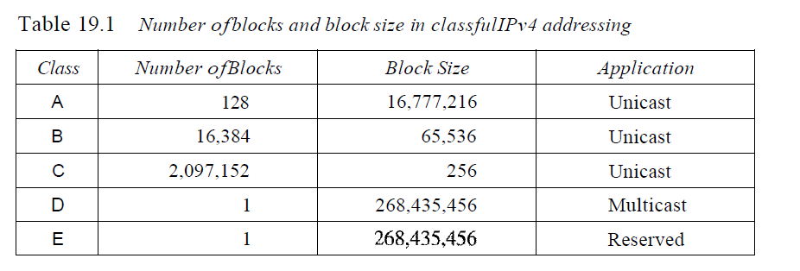
Classes and Blocks
One problem with classful addressing is that each class is divided into a fixed number of blocks with each block having a fixed size
The classful addressing wastes a large part of the address space

Slide 49
INTRODUCTION to Internet Protocol, Version 6 (IPv6)

Slide 50
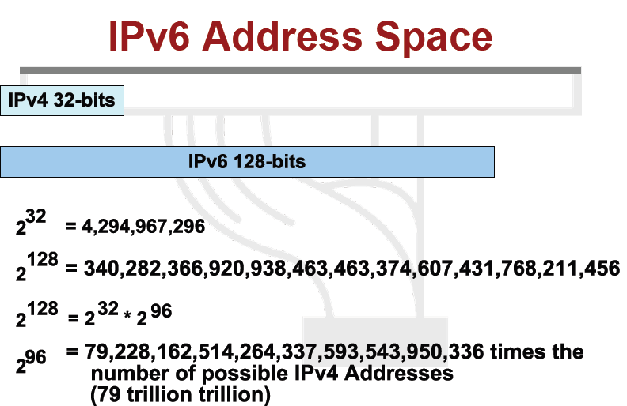

Slide 51
Why IPv6?
Deficiency of IPv4
Address space exhaustion
New types of service 🡪 Integration
Multicast
Quality of Service
Security
Mobility (MIPv6)
Header and format limitations

Slide 52
IPv4 & IPv6 Header Comparison
IPv4 Header
IPv6 Header
Version | IHL | Type of Service | Total Length
Identification |  |  | Flags | Fragment Offset
Time to Live |  | Protocol | Header Checksum
Source Address
Destination Address
Options |  |  |  |  | Padding
Version | Traffic Class | Flow Label
Payload Length |  |  | Next Header | Hop Limit
Source Address
Destination Address
- field’s name kept from IPv4 to IPv6
- fields not kept in IPv6
- Name & position changed in IPv6
- New field in IPv6
Legend

Slide 53
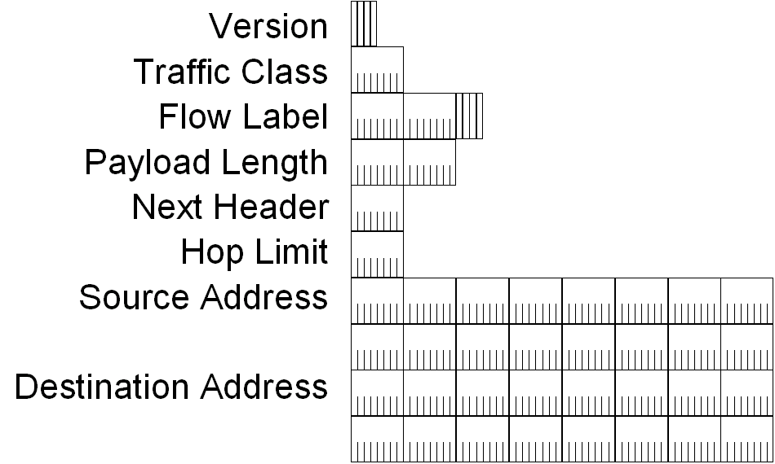
IPv6 Header

Slide 54
IPv6 Header Fields
Based on these rules, RFC 2460 defines the following IPv6 header fields:
Version (4 bits)
4 bits are used to indicate the version of IP and is set to 6
Traffic Class (8 bits)
same function as the Type of Service field in the IPv4 header.
Flow Label (20 bits)
identifies a flow and it is intended to enable the router to identify packets that should be treated in a similar way without the need for deep lookups within those packets.
set by the source and should not be changed by routers along the path to destination.

Slide 55
IPv6 Header Fields
Payload Length (16 bits)
With the header length fixed at 40 bytes, it is enough to indicate the length of the payload to determine the length of the entire packet.
Next Header (8 bits)
Indicates either the first extension header (if present) or the protocol in the upper layer PDU (such as TCP, UDP, or ICMPv6).
Hop Limit (8 bits)
In IPv6, the IPv4 TTL was appropriately renamed Hop Limit because it is a variable that is decremented at each hop, and it does not have a temporal dimension.

Slide 56
IPv6 Header Fields
Source IPv6 Address (128 bits)
Stores the IPv6 address of the originating host.
Destination IPv6 Address (128 bits)
Stores the IPv6 address of the current destination host.

Slide 57
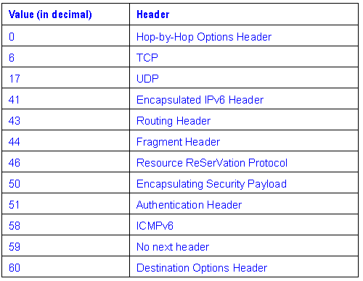
Values of the Next Header Field

Slide 58
Basis for differences | IPv4 | IPv6
Size of IP address | IPv4 is a 32-Bit IP Address. | IPv6 is 128 Bit IP Address.
Addressing method | IPv4 is a numeric address, and its binary bits are separated by a dot (.) | IPv6 is an alphanumeric address whose binary bits are separated by a colon (:). It also contains hexadecimal.
Number of header fields | 12 | 8
Length of header filed | 20 | 40
Checksum | Has checksum fields | Does not have checksum fields
Example | 12.244.233.165 | 2001:0db8:0000:0000:0000:ff00:0042:7879
Type of Addresses | Unicast, broadcast, and multicast. | Unicast, multicast, and anycast.
Number of classes | IPv4 offers five different classes of IP Address. Class A to E. | lPv6 allows storing an unlimited number of IP Address.
Configuration | You have to configure a newly installed system before it can communicate with other systems. | In IPv6, the configuration is optional, depending upon on functions needed.
VLSM support | IPv4 support VLSM (Virtual Length Subnet Mask). | IPv6 does not offer support for VLSM.
Fragmentation | Fragmentation is done by sending and forwarding routes. | Fragmentation is done by the sender.

Slide 59
Basis for differences | IPv4 | IPv6
Routing Information Protocol (RIP) | RIP is a routing protocol supported by the routed daemon. | RIP does not support IPv6. It uses static routes.
Network Configuration | Networks need to be configured either manually or with DHCP. IPv4 had several overlays to handle Internet growth, which require more maintenance efforts. | IPv6 support autoconfiguration capabilities.
Best feature | Widespread use of NAT (Network address translation) devices which allows single NAT address can mask thousands of non-routable addresses, making end-to-end integrity achievable. | It allows direct addressing because of vast address Space.
Address Mask | Use for the designated network from host portion. | Not used.
Security | Security is dependent on applications - IPv4 was not designed with security in mind. | IPSec(Internet Protocol Security) is built into the IPv6 protocol, usable with a proper key infrastructure.
Packet size | Packet size 576 bytes required, fragmentation optional | 1208 bytes required without fragmentation
IP to MAC resolution | Broadcast ARP | Multicast Neighbour Solicitation
Optional Fields | Has Optional Fields | Does not have optional fields. But Extension headers are available.
Dynamic host configuration Server | Clients have approach DHCS (Dynamic Host Configuration server) whenever they want to connect to a network. | A Client does not have to approach any such server as they are given permanent addresses.
Mapping | Uses ARP(Address Resolution Protocol) to map to MAC address | Uses NDP(Neighbour Discovery Protocol) to map to MAC address

Slide 60
Advantages of IPv6 over IPv4
Larger address space
Better header format
New options
Allowance for extension
Support for resource allocation
Support for more security
Support for mobility

Slide 61
Classless addressing - Variable length blocks- Two level addressing- Block allocation - Sub netting- problem solving

Slide 62
Classless Addressing
To overcome address depletion and give more organizations access to the Internet, classless addressing was designed and implemented.

Slide 63
Classless Addressing
Address Blocks
In classless addressing, when an entity, small or large, needs to be connected to the Internet, it is granted a BLOCK (RANGE) OF ADDRESSES.
The size of the block (the number of addresses) varies based on the nature and size of the entity.
For example:
A household 🡪 only two addresses
A large organization 🡪 given thousands of addresses.
An ISP, as the Internet service provider 🡪 given thousands or hundreds of thousands based on the number of customers it may serve.

Slide 64
Restriction
To simplify the handling of addresses, the Internet authorities impose three restrictions on classless address blocks:
Addresses in a block must be contiguous, one after another.
Number of addresses in a block must be a power of 2 (I, 2, 4, 8, ... ).
First address must be evenly divisible by the number of addresses.

Slide 65
Mask or subnet Mask
A better way to define a block of addresses is to select any address in the block and the mask.
A mask is a 32-bit number in which
n leftmost bits are 1 s
32 - n rightmost bits are O s.
In classless addressing the mask for a block can take any value from 0 to 32.
It is very convenient to give just the value of n preceded by a slash (CIDR notation).

Slide 66
Network Address
Can be found by setting the 32 - n rightmost bits in the binary notation of the address to Os.
Example
A block of addresses is granted to a small organization. We know that one of the addresses is 205.16.37.39/28. What is the first/network address in the block?
Solution
The binary representation of the given address is 11001101 00010000 00100101 00100111.
If we set 32 - 28 rightmost bits to 0, we get 11001101 0001000 00100101 00100000 or 205.16.37.32.

Slide 67
Broadcast Address
Can be found by setting the 32 - n rightmost bits in the binary notation of the address to 1 s.
Example:
A block of addresses is granted to a small organization. We know that one of the addresses is 205.16.37.39/28. What is the last/broadcast address in the block? Solution
The binary representation of the given address is 11001101 00010000 00100101 00100111.
If we set 32 - 28 rightmost bits to 1, we get 11001101 00010000 00100101 00101111 or 205.16.37.47.

Slide 68
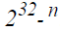
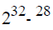
Number of Addresses
The number of addresses in the block is the difference between the last and first address.
It can easily be found using the formula .
Eg: Find the number of addresses in above Example.
Soln
The value of n is 28, which means that number of addresses is or 16.

Slide 69
Example
Another way to find the network address, the broadcast address, and the number of addresses is to represent the mask as a 32-bit binary (or 8-digit hexadecimal) number.
Eg: /28 can be represented as
11111111 11111111 11111111 11110000 (twenty-eight Is and four Os).
Find
Network address
Broadcast address
The number of addresses

Slide 70
Network/subnet address
Found by ANDing the given addresses with the mask.
ANDing here is done bit by bit. The result of ANDing 2 bits is 1 if both bits are Is; the result is 0 otherwise.
Address: 11001101 00010000 00100101 00100111
Mask: 11111111 11111111 11111111 11110000
Network
address/
neid/
subnet address: 11001101 00010000 00100101 00100000
(or)
` 205.16.37.32.

Slide 71
Broadcast address
Found by ORing the given addresses with the complement of the mask. ORing here is done bit by bit.
The result of ORing 2 bits is 0 if both bits are Os; the result is 1 otherwise.
The complement of a number is found by changing each 1 to 0 and each 0 to 1.
Address: 11001101 00010000 00100101 00100111
Mask : 00000000 00000000 00000000 00001111
Broadcast
add: 11001101 00010000 00100101 00101111
(or)
205.16.37.47.

Slide 72
Number of addresses
The number of addresses can be found by complementing the mask, interpreting it as a decimal number, and adding 1 to it.
Mask complement:
000000000 00000000 00000000 00001111
Number of addresses: 15 + 1 =16

Slide 73
Subnetting
Subnetting - which allows you to take one larger network and break it into many smaller networks.
Reduced network traffic
Optimized network performance
Simplified management
Facilitated spanning of large geographical distances
Subnet Masks
Every machine on the network must know which part of the host address will be used as the subnet address

Slide 74
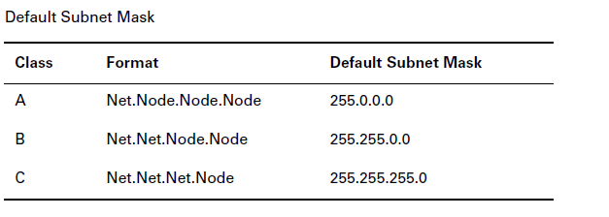

Slide 75
Subnetting Class C Addresses
The Binary Method: Subnetting a Class C Address
The first subnet mask available with a Class C address, which borrows two bits from subnetting. For this example, we are using 255.255.255.192.
192=11000000 Two bits for subnetting, 6 bits for defining the hosts in
each subnet. What are the subnets?
01000000=64 (all host bits off)
or
10000000=128 (all host bits off)

Slide 76
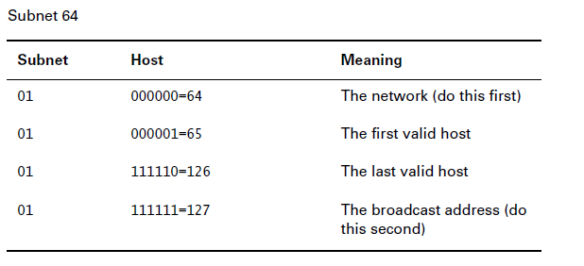
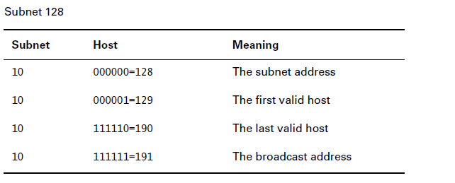

Slide 77
The Alternate Method: Subnetting a Class C Address
1. How many subnets does the subnet mask produce?
2. How many valid hosts per subnet?
3. What are the valid subnets?
4. What are the valid hosts in each subnet?
5. What is the broadcast address of each subnet?
Here is how you determine the answers to the five questions:
1. How many subnets? 2x–2=amount of subnets. X is the amount of masked bits, or the 1s. For example, 11000000 is 22–2. In this example, there are 2 subnets.
2. How many hosts per subnet? 2x–2=amount of hosts per subnet. X is the amount of unmasked bits, or the 0s. For example, 11000000 is 26–2. In this example, there are 62 hosts per subnet.
3. What are the valid subnets? 256–subnet mask=base number. For example, 256–192=64. Keep adding the variable to itself until you reach the subnet mask.
4. What are the valid hosts? Valid hosts are the numbers between the subnets, minus all 0s and all 1s.
5. What is the broadcast address for each subnet? Broadcast address is all host bits turned on, which is the number immediately preceding the
next subnet.

Slide 78
Practice Example 2: 255.255.255.224
In this example, you will subnet the network address 192.168.10.0 and subnet mask 255.255.255.224.

Slide 79
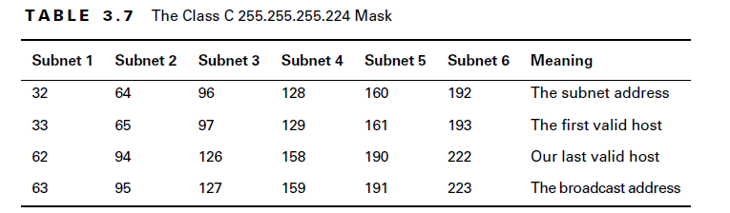

Slide 80
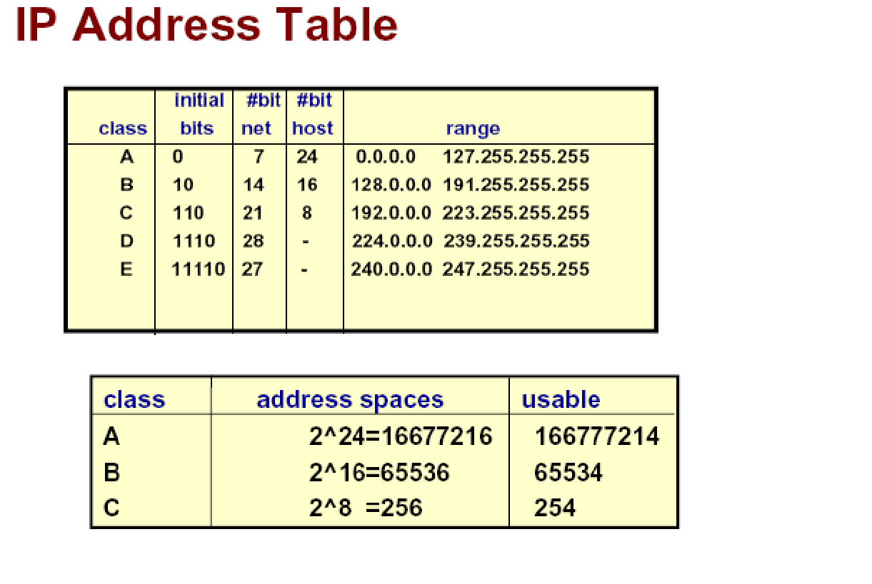

Slide 81
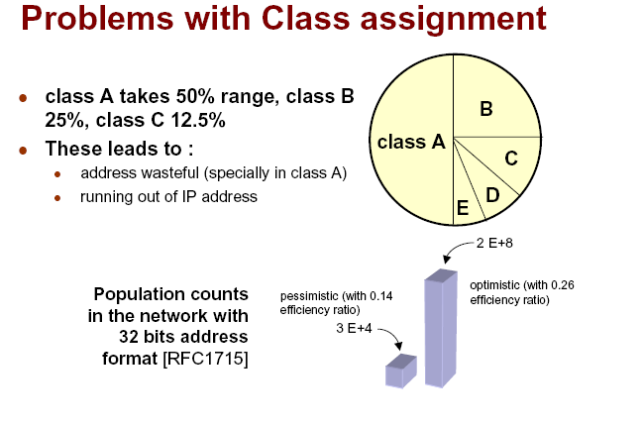

Slide 82
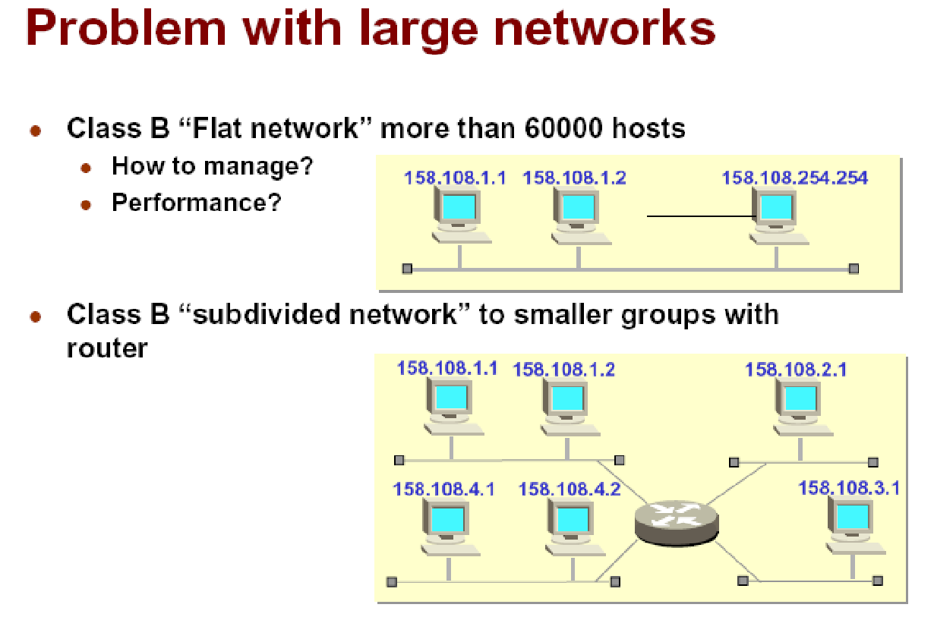

Slide 83
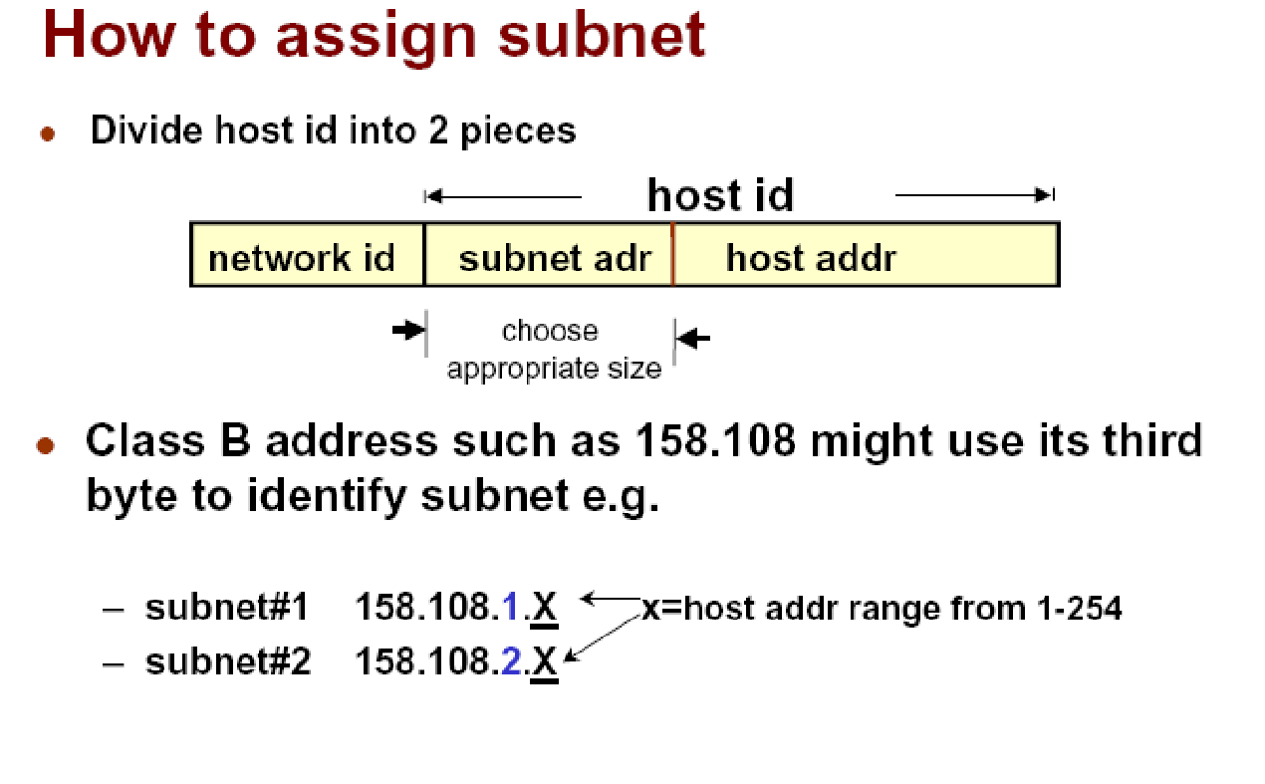

Slide 84
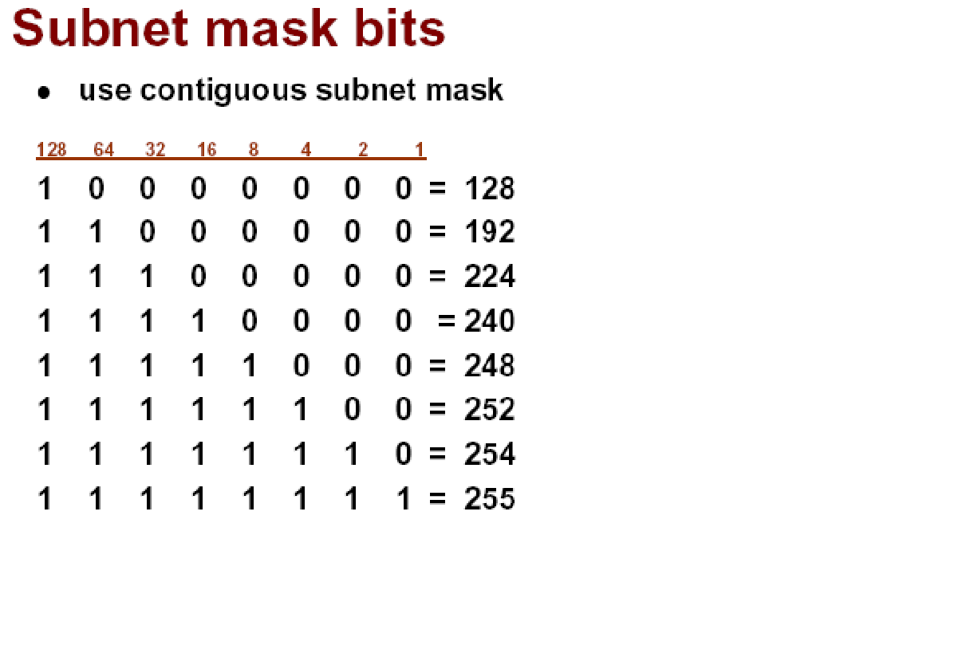

Slide 85
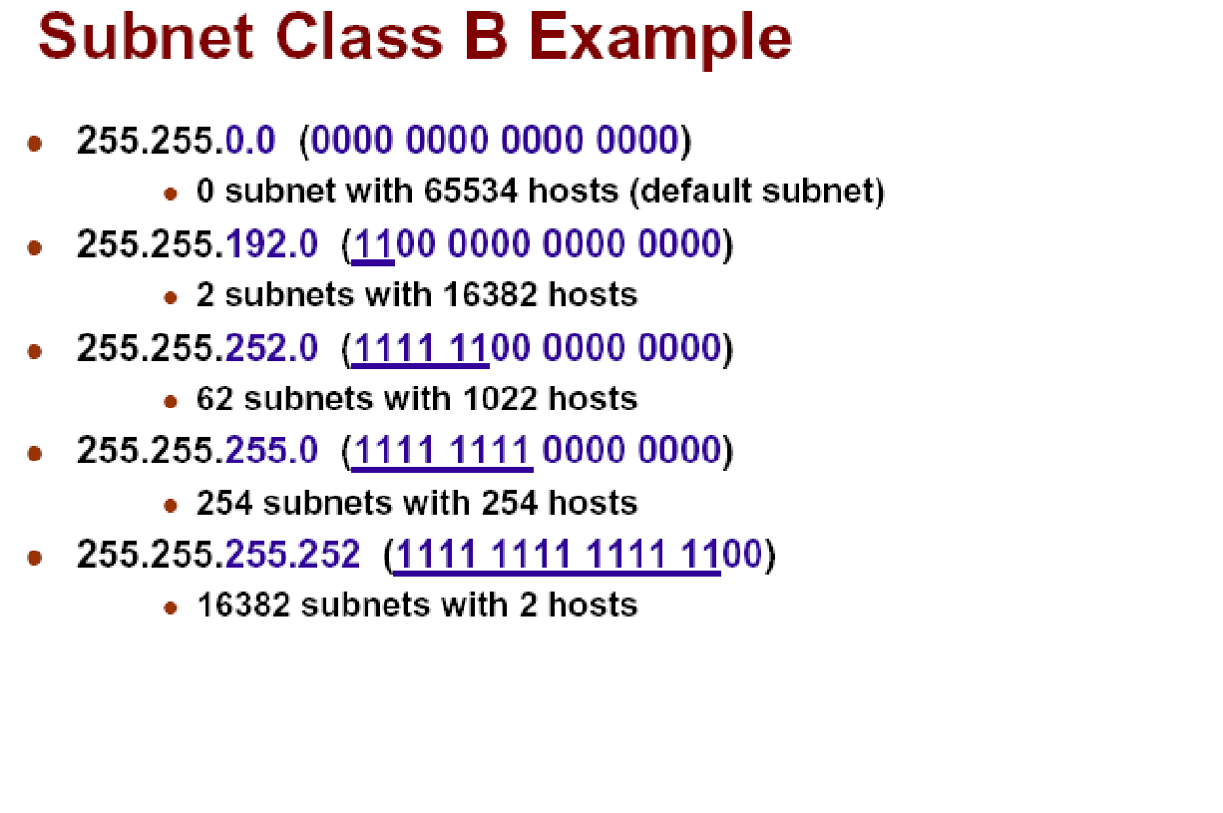

Slide 86
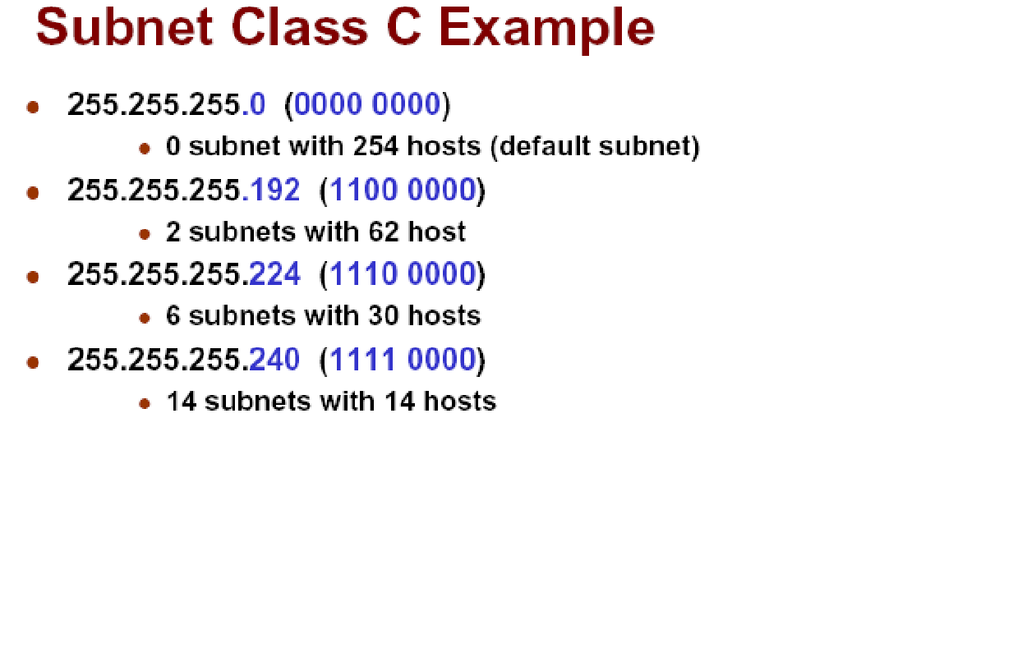

Slide 87
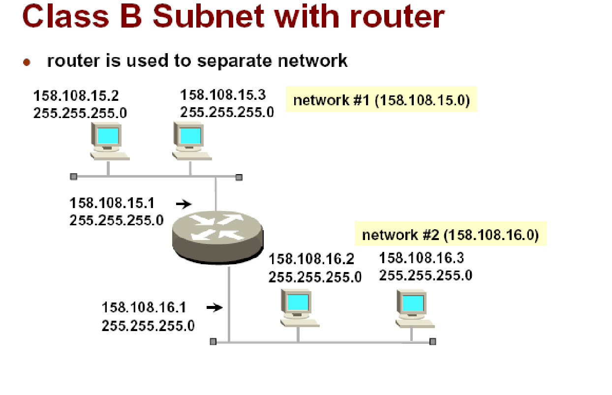

Slide 88
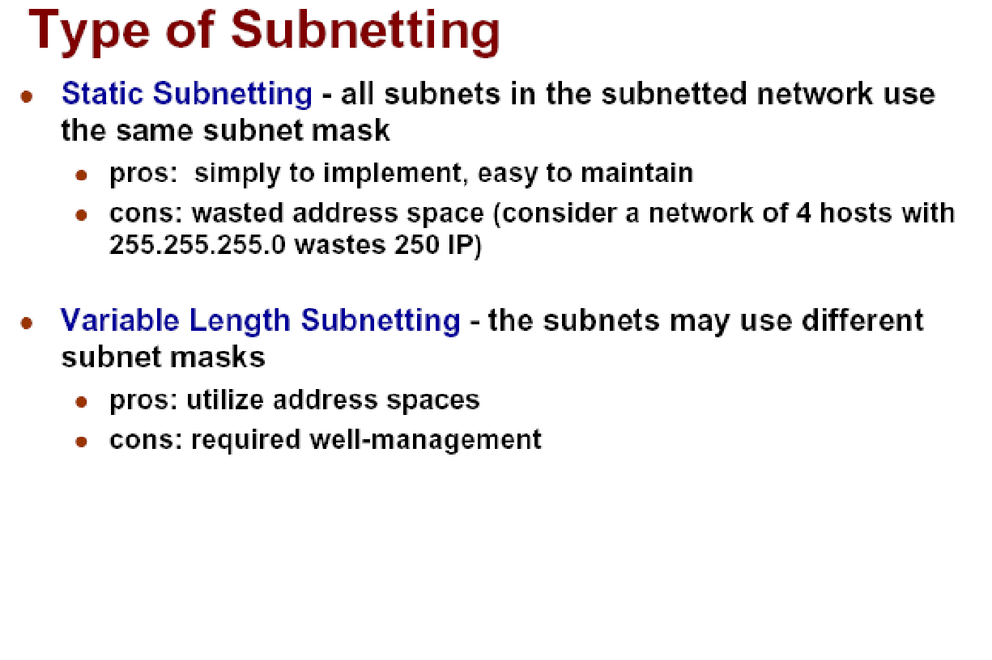

Slide 89
Private address, Network addresses translation -Super netting.

Slide 90
PUBLIC & PRIVATE ADDRESSES IN IPV4
If direct (routed) or indirect (proxy or translator) connectivity to the Internet is desired, there are two types of addresses employed on the Internet
Public addresses
Private addresses

Slide 91
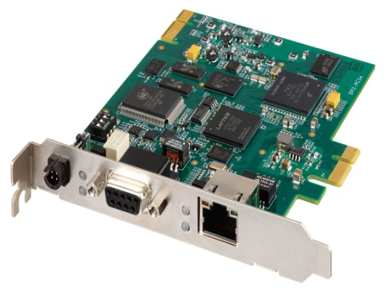
Public addresses
Public addresses are assigned by NETWORK INTERFACE CARD (NIC) - A network interface card (NIC) is a circuit board or card that is installed in a computer so that it can be connected to a network.
Consist of class-based network IDs or blocks of CIDR-based addresses (called CIDR blocks) that are guaranteed to be globally unique to the Internet.
When the public addresses are assigned, routes are programmed into the routers of the Internet so that traffic to the assigned public addresses can reach their locations.

Slide 92
Public Addresses
Public ip are the ip that can be accessed by every one (i,e) every user has the access to this ip's.
E.g: Yahoo.com, Google.com etc are the pubic ip's.

Slide 93
Private Addresses
Private IP addresses are used for numbering the computers in a private network including home, school/Colleges/Universities and business LANs in airports and hotels which makes it possible for the computers in the network to communicate with each other.
Private ip's are the ip that cannot be accessed by every one(i,e) they are privately owned by an organization / private concern. Only the user of that organisation has the access to this ip's.
Eg : SRM University

Slide 94
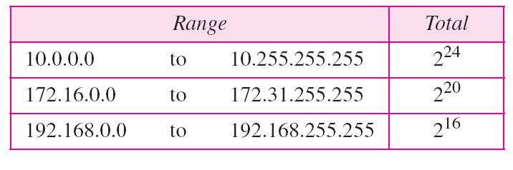
Range of private ip
Four blocks are assigned as private addresses: 10.0.0.0/8, 172.16.0.0/12, 192.168.0.0/16.
Range of private IP address are
excluding ips are public ip's.

Slide 95
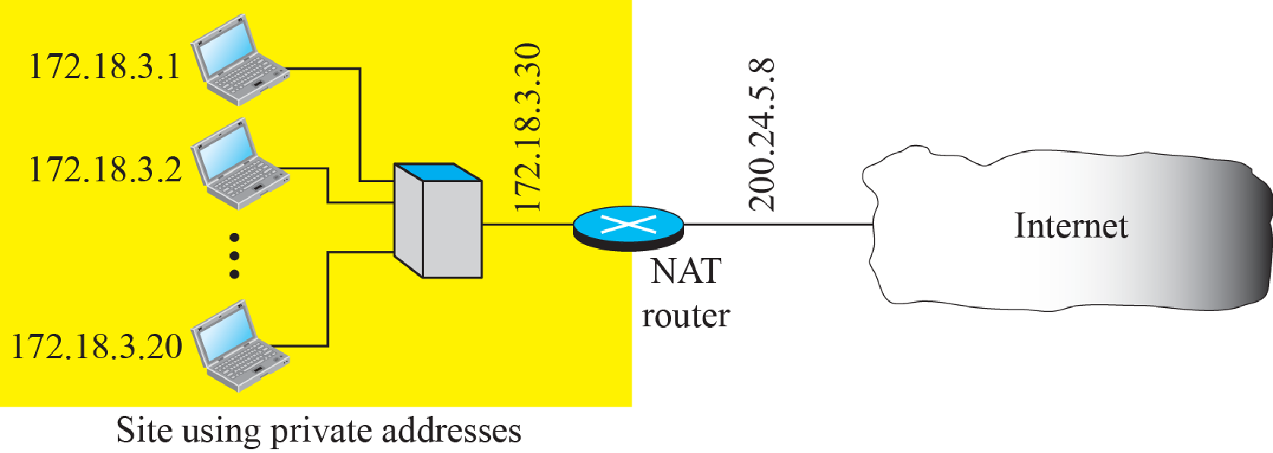
NAT – Network Address Translation
A technology that can provide the mapping between the private and universal addresses, and at the same time support virtual private networks.
Allows a site to use a set of private addresses for internal communication and a set of global Internet addresses (atleast one) for communication with the rest of the world.

Slide 96
Network Address Translation
There are different flavors of NAT:
Static NAT Designed to allow one-to-one mapping between local and global addresses.
Dynamic NAT Designed to map an unregistered IP address to a registered IP address from out of a pool of registered IP addresses.
Overloading This is the most popular type of NAT configuration. Overloading is a form of dynamic NAT that maps multiple unregistered IP addresses to a single registered IP address (many-to-one) by using different ports.

Slide 97
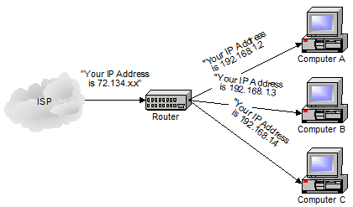
Example

Slide 98
NAT – Network Address Translation
It is the way that the router translates the IP addresses of packets that cross the internet/local network boundary.
When computer “A” sends a packet out “from” that of computer “A” – 192.168.1.2. When the router passes that packet on to the internet, it replaces the local IP address with the internet IP address assigned by the ISP.
It also keeps track, so that if a response comes back from somewhere on the internet, the router knows to do the translation in reverse – replace the internet IP address with the local IP address for machine “A” and then send that response packet on to machine “A”.
NAT is not restricted to private-to-public address translation, though that is the most common application.
NAT can also perform public-to-public address translation, as well as private-to-private address translation.

Slide 99
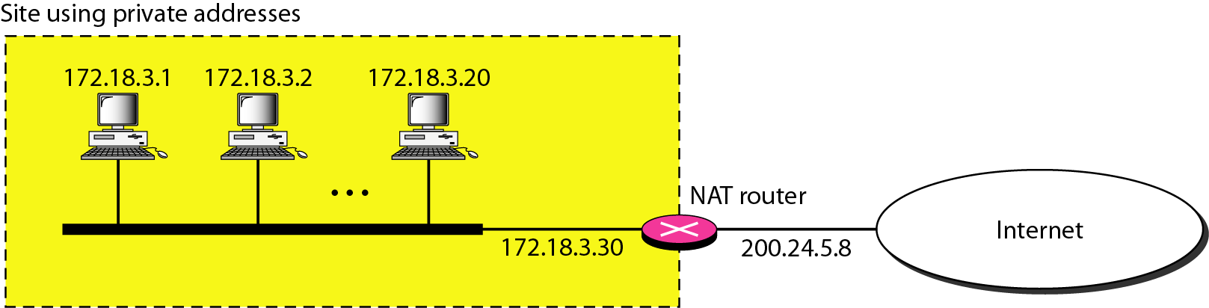
Figure 19.10 A NAT implementation

Slide 100
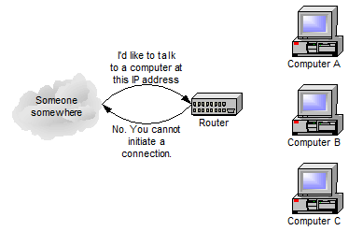
Network Address Translation (NAT)
Benefits
Use of a single IP address among many devices in a network
Use of a dynamic IP address for home user for sharing
Drawbacks
Machines on the internet cannot initiate communications to local machines – they can only respond to communications initiated by those local machines. The net effect is that the router then also acts as a firewall.

Slide 101
Subnetting vs supernetting Subnetting:
Divide a large address block into smaller sub-groups.
If an organization was granted a large block in class A or B, it could divide the addresses into several contiguous groups and assign each group to smaller networks (called subnets).
Use of flexible net mask.

Slide 102
Supernetting
In supernetting, an organization can combine several class C blocks to create a larger range of addresses.
In other words, several networks are combined to create a supernetwork or a supernet.
For example:
An organization that needs 1000 addresses can be granted four contiguous class C blocks.

Slide 103
Intermediate devices - Hub, Repeaters, Switch, Bridge- Gateways -Structure of a ROUTER

Slide 104
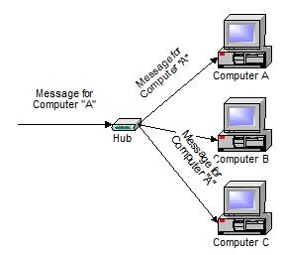
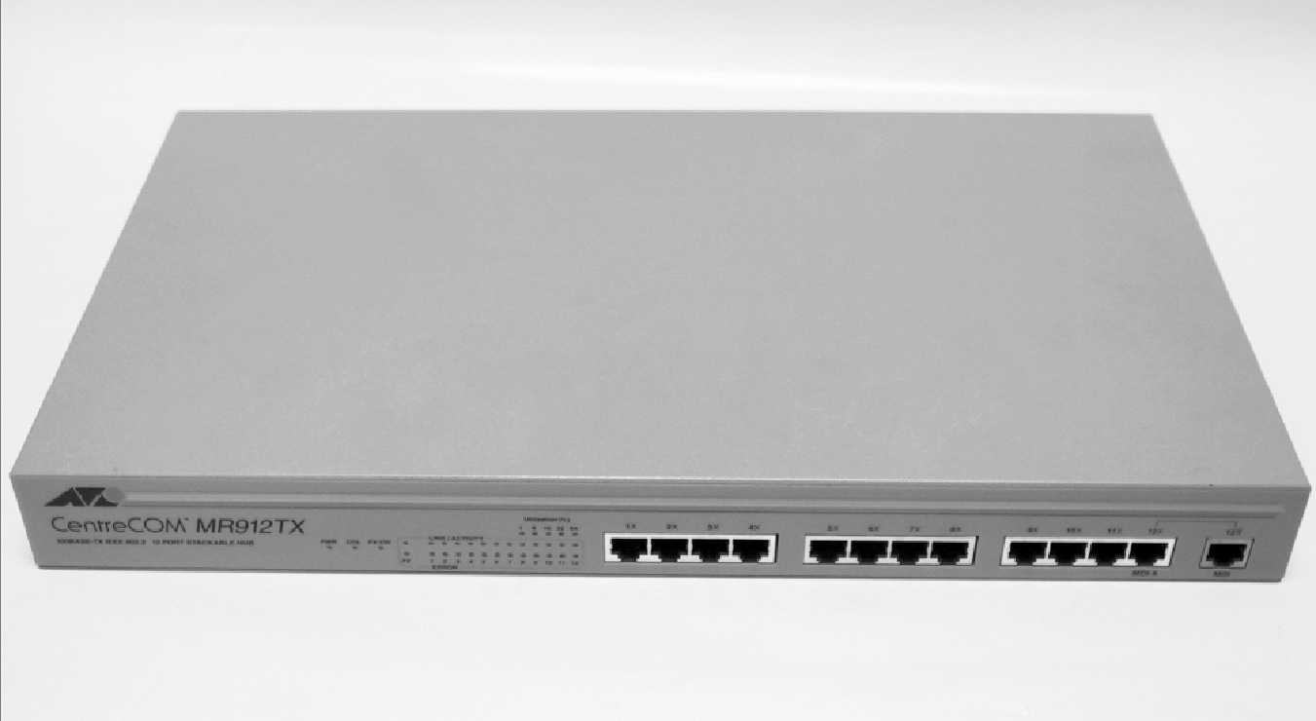
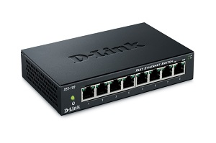
Intermediate devices - Hubs
A hub is typically the least expensive, least intelligent, and least complicated. Its job is very simple – anything that comes in one port is sent out to the others. That is it broadcasts everything.
If a message comes in for computer “A”, that message is sent out all the other ports, regardless of which one computer “A” is on:

Slide 105
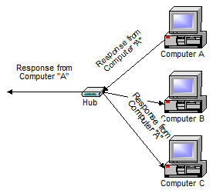
Hubs
And when computer “A” responds, its response also goes out to every other port on the hub:
Every computer connected to the hub “sees” everything that every other computer on the hub sees. The computers themselves decide if they are the targeted recipient of the message and when a message should be paid attention to or not.

Slide 106
Types of Hub
Active Hub:- These are the hubs which have their own power supply and can clean, boost and relay the signal along with the network. It serves both as a repeater as well as wiring centre. These are used to extend the maximum distance between nodes.
Passive Hub :- These are the hubs which collect wiring from nodes and power supply from active hub. These hubs relay signals onto the network without cleaning and boosting them and can’t be used to extend the distance between nodes.

Slide 107
Drawbacks
Hubs cannot filter data, so data packets are sent to all connected devices.
They do not have intelligence to find out best path for data packets which leads to inefficiencies and wastage.

Slide 108
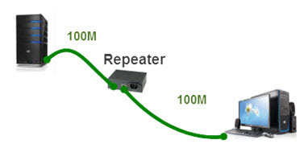

Repeaters
Ethernet Repeaters
A repeater operates at the physical layer.
Its job is to regenerate the signal over the same network before the signal becomes too weak or corrupted so as to extend the length to which the signal can be transmitted over the same network.
They do not amplify the signal. When the signal becomes weak, they copy the signal bit by bit and regenerate it at the original strength.
It is a 2 port device.
Because the functionality of repeaters has been built in to other devices, such as hubs and switches, repeaters are rarely used.

Slide 109



Switches
A switch does essentially what a hub does, but more efficiently.
By paying attention to the traffic that comes across it, it can “learn” where particular addresses are.
Initially, a switch knows nothing and simply sends on incoming messages to all ports:
A 32-port Ethernet switch.

Slide 110

Switches
Even accepting that first message, however, the switch has learned something – it knows on which connection the sender of the message is located.
Thus, when machine “A” responds to the message, the switches only need to send that message out to the one connection:

Slide 111

Switches
In addition to sending the response through to the originator, the switch has now learned something else – it now knows on which connection machine “A” is located.
That means that subsequent messages destined for machine “A” need only be sent to that one port:

Slide 112
Switches
Switches learn the location of the devices that they are connected to almost instantaneously.
A switch is a data link layer device.
The switch can perform error checking before forwarding data, that makes it very efficient as it does not forward packets that have errors and forward good packets selectively to correct port only.
The net result is that most network traffic only goes where it needs to rather than to every port.
On busy networks, this can make the network significantly faster.

Slide 113


Bridge
A bridge operates at data link layer.
A bridge is a repeater, with add on the functionality of filtering content by reading the MAC addresses of source and destination.
It is also used for interconnecting two LANs working on the same protocol.
It has a single input and single output port, thus making it a 2 port device.

Slide 114
Types of Bridges
Transparent Bridges:-
These are the bridge in which the stations are completely unaware of the bridge’s existence i.e. whether or not a bridge is added or deleted from the network, reconfiguration of the stations is unnecessary.
These bridges make use of two processes i.e. bridge forwarding and bridge learning.
Source Routing Bridges:-
In these bridges, routing operation is performed by source station and the frame specifies which route to follow.
The host can discover frame by sending a special frame called discovery frame, which spreads through the entire network using all possible paths to destination.
Translational bridge:-
A translational bridge can convert from one networking system to another.
It translates the data it receives.
Translational bridges are useful for connecting two different networks, such as Ethernet and Token Ring networks.

Slide 115
Gateway
A gateway, is a passage to connect two networks together that may work upon different networking models.
They basically work as the messenger agents that take data from one system, interpret it, and transfer it to another system.
Gateways are also called protocol converters and can operate at any network layer.
The term gateway is applied to any device, system, or software application that can perform the function of translating data from one format to another.
The key feature of a gateway is that it converts the format of the data, not the data itself.

Slide 116

Gateway

Slide 117


Router
Routers are network devices that literally route data around the network.
By examining data as it arrives, the router can determine the destination address for the data; then, by using tables of defined routes, the router determines the best way for the data to continue its journey.
Router is mainly a Network Layer device. Routers normally connect LANs and WANs together.
Cisco Router

Slide 118
Router
Unlike bridges and switches, which use the hardware-configured MAC address to determine the destination of the data, routers use the software-configured network address to make decisions.
This approach makes routers more functional than bridges or switches, and it also makes them more complex because they have to work harder to determine the information.

Slide 119
Functionality:
When a router receives the data, it determines the destination address by reading the header of the packet. Once the address is determined, it searches in its routing table to get know how to reach the destination and then forwards the packet to the higher hop on the route. The hop could be the final destination or another router.

Slide 120
Routing tables play a very pivotal role in letting the router makes a decision. Thus a routing table is ought to be updated and complete.
The two ways through which a router can receive information are:
Static Routing: In static routing, the routing information is fed into the routing tables manually. It does not only become a time-taking task but gets prone to errors as well. The manual updating is also required in case of statically configured routers when change in the topology of the network or in the layout takes place. Thus static routing is feasible for tinniest environments with minimum of one or two routers.

Slide 121



Slide 122
Brouters
Brouters are the combination of both the bridge and routers. They take up the functionality of the both networking devices serving as a bridge when forwarding data between networks, and serving as a router when routing data to individual systems. Brouter functions as a filter that allows some data into the local network and redirects unknown data to the other network.
Brouters are rare and their functionality is embedded into the routers functioned to act as bridge as well.

Slide 123

PROBLEMS –SUBNETTING NUMERALS

Slide 124


Slide 125


Slide 126


Slide 127


Slide 128


Slide 129


Slide 130


Slide 131


Slide 132


Slide 133


Slide 134


Slide 135


Slide 136


Slide 137


Slide 138


Slide 139


Slide 140


Slide 141


Slide 142


Slide 143


